Slide 1
Importance of
Community Water Fluoridation (CWF)
August 2024

Slide 2
A fluoride timeline
1874 1901
1945
1956
1995
1999
A German doctor conducts an animal test and finds that fluoride protects tooth enamel.
Studies begin to learn whether fluoride cuts the cavity rate.
Cavities fall dramatically.
The U.S. Surgeon General calls fluoridation “the
cornerstone” of dental
prevention.
Dr. Frederick McKay, a dentist, moves to Colorado and learns
CDC names fluoridation one
Crest starts selling fluoride toothpaste to the consumer market.
of a city where many people’s teeth have “brown spots” but cavities are rare.
of 10 great public health achievements.
(Sources: Schneider & Lilienfeld, Public Health: The Development of a Discipline, Volume. II: Twentieth Century Challenges, Rutgers Univ Press, 2011; National Institutes of Health/NIDCR, “The Story of Fluoridation,” reviewed in July 2018; Sander K, “The Invention of Fluoride Toothpaste,” Indiana Public Media, July 10, 2006; Dr. Audrey F. Manley, 1995 Surgeon General’s Statement on Community Water Fluoridation; Morbidity & Mortality Weekly Report, April 2, 1999, Vol. 48, No. 12.)

Slide 3
CDC’s Top 10 Greatest Public Health Achievements of the 20th Century in the U.S.
Vaccination
Motor-vehicle safety
Safer workplaces
Control of infectious diseases
Decline in deaths from coronary heart disease and stroke
Safer and healthier foods
Healthier mothers and babies
Family planning
Fluoridation of drinking water
Recognition of tobacco use as a health hazard

Slide 4


Fluoride: A naturally occurring mineral
13th most abundant mineral in the earth’s crust
Surface water (rivers)— typically low concentrations, 0.2 mg/L (ppm) or less
Groundwater (wells) — higher concentrations, 0.1 mg/L to over 5.0 mg/L
Ocean is typically 0.8 to 1.4 mg/L
(Sources: Centers for Disease Control and Prevention, “Fluoridation Basics,” web page updated January 28, 2021; Kanduti D, Sterbenk P, Artnik B. Fluoride: A Review of Use and Effects on Health, MateriaSocioMedica, 2016, 28:2.)

Slide 5
A Partnership
Water facilities and water operators perform a valuable public service by carefully adjusting the level of fluoride in water to improve the oral health of the community
If you have running water in your home and your water system fluoridates, then you are drinking and cooking with optimally fluoridated water
Fluoridated water is odorless, colorless and tasteless
Since it is system wide, everyone can benefit, regardless of income
*Adjusting fluoride to levels optimal for oral health can be equated to the supplementation of salt with iodine

Slide 6



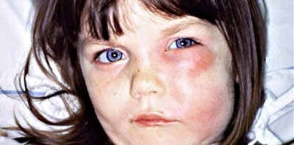
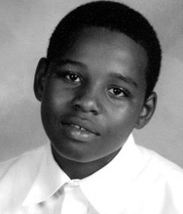
Why Oral Health Matters
Dental cavities are the most common chronic disease for children and teens. It’s significantly more common than asthma, obesity, and diabetes. Infectious and Transmissible
Severe pain (toothaches)
Difficulty in chewing
Poor weight gain
Difficulty concentrating
Predictor of cavities later in life
Costly to treat
Deaths

Slide 7
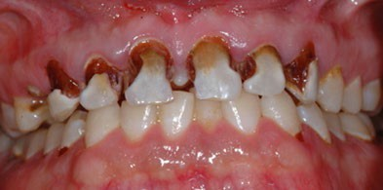
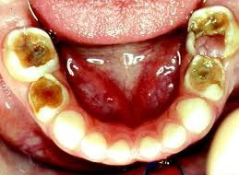
Cavities are unevenly distributed
Cavities affect everyone, regardless of age, SES, race, ethnicity, level of education, or access to dental care.
Low-income kids are more than twice as likely to experience cavities.

Slide 8
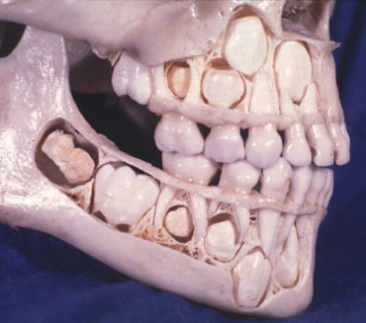
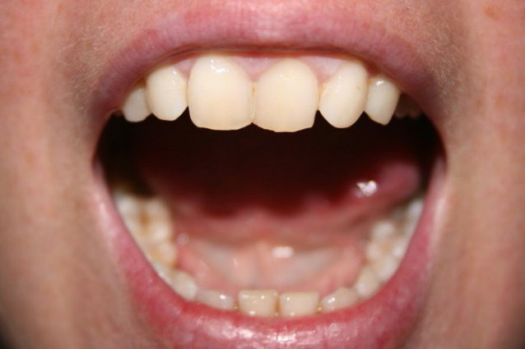
How fluoride works
Systemically – Fluoridated water
Fluoride helps strengthen the developing permanent teeth before they come through the gums.
Topically – Fluoridated water, toothpaste, mouth rinse, and varnish
Continuous exposure to small amounts of fluoride helps both adults and children by remineralizing the tooth enamel.
(Source: Achievements in Public Health, 1900-1999: Fluoridation of Drinking Water to Prevent Dental Caries, MMWR, October 22, 1999, 48:41; as this scientific article notes, “Fluoride from topical sources such as fluoridated drinking water is taken up by cariogenic bacteria when they produce acid.”)

Slide 9


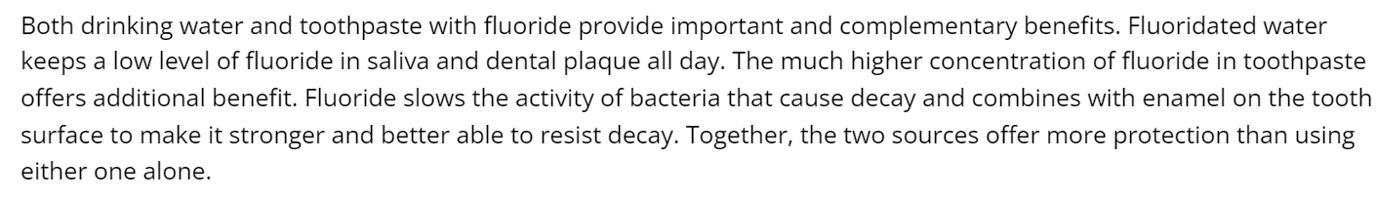
Both forms of fluoride are needed
“If I’m using fluoride toothpaste, do I still need to drink fluoridated water?
(Source: Centers for Disease Control and Prevention, “Community Water Fluoridation” web page, July 25, 2023.)

Slide 10
The impact of fluoride in water and toothpaste
Over a 50-year period, a major drop in the share of
U.S. adults who had lost all of their teeth (edentulous):
38% of adults (aged 55-64) were
edentulous during 1957-1958
Only 6% of adults (aged 55-64) were edentulous during 2009-2012
Lost all of their teeth
Retained some or all of their teeth
(Sources: G.D. Slade et al. Projections of U.S. Edentulism Prevalence Following 5 Decades of Decline, Journal of Dental Research, 2014, 93:10, pp. 959-965.)

Slide 11

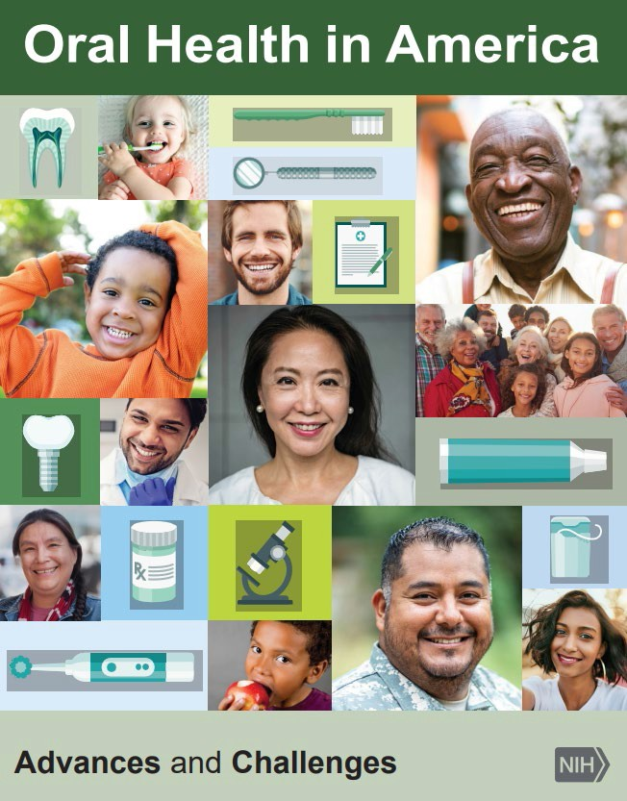
Fluoridation: A great way to benefit everyone
National Institutes of Health:
Reaching more people with fluoridation “not only benefits the entire population but disproportionally benefits economically vulnerable groups” that lack access to regular dental care.
(Source: National Institutes of Health, Oral Health in America: Advances and Challenges, December 2021.)

Slide 12
Concentration
The new guidance advises community water systems to adopt a uniform concentration of 0.7 mg/L of fluoride in drinking water, a change from 1 mg/L, ensuring cavity prevention benefits while minimizing the risk of developing mild dental fluorosis.
  1 Part Per Million (PPM) means for every million particles of water, there is 1 particle of fluoride
  1 mg/L = 1 PPM
Therefore, public water systems nationwide commenced fluoridation at the recommended 0.7 PPM level.

Slide 13
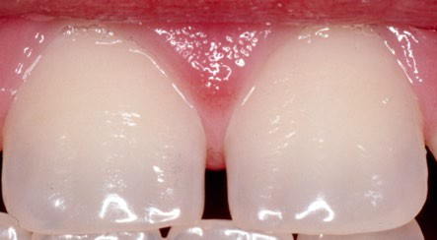
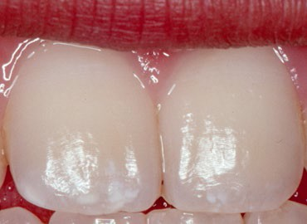
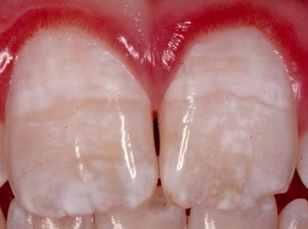
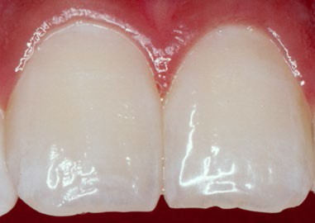
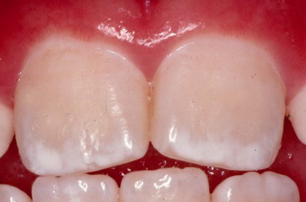
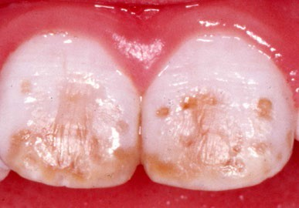
What about dental fluorosis?
Variations in tooth enamel (fluorosis)
Improper use of fluoride products
Normal
Very Mild
Moderate
Not caused by fluoridation
Questionable
Mild
Severe
(Source: Information from the Centers for Disease Control and Prevention’s website, accessed in July 14, 2023 at http://www.cdc.gov/fluoridation/faqs/dental_fluorosis/index.htm )

Slide 14




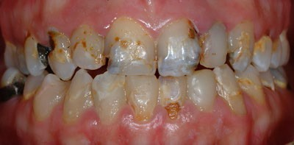
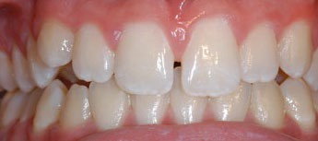
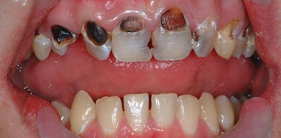
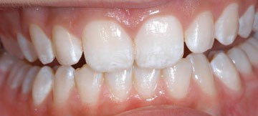
Dental fluorosis
Which would you rather have?
Cavities OR Mild fluorosis

Slide 15

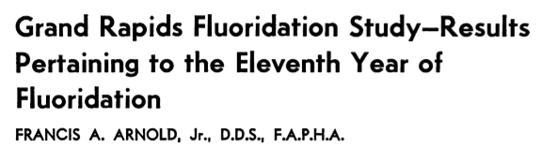
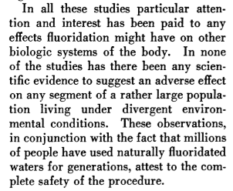
The early studies took safety seriously
The 1940s studies included various tests that confirmed fluoridation did not have negative health
effects.
(Source: F.A. Arnold, Jr., “Grand Rapids Fluoridation Study-Results Pertaining to the Eleventh Year of Fluoridation,” American Journal of Public Health, May 1957, pp. 539-545.)

Slide 16
Fluoride levels
The U.S. Environmental Protection Agency (EPA) must review fluoride levels in drinking water every 6 years for safety in consumption in drinking water. This review consistently shows water fluoridation is safe under 4mg/L (or PPM)
The U.S. Environmental Protection Agency (EPA) recommends that drinking water contain no more than 2.0 mg/L of fluoride. This is a non-enforceable guideline and is intended to help children avoid dental fluorosis
When water fluoride levels exceed 2.0 mg/L, water systems are required to notify customers of the increased potential for dental fluorosis
  Less than 1% of the U.S. population has water from private wells or drinking systems with fluoride higher than 2.0 mg/L

Slide 17
Dosage
The single dose (consumed at one time) of fluoride that could cause acute fluoride toxicity is 5 mg/kg of body weight (11mg/kg of body weight of sodium fluoride).
This dose is considered the probably toxic dose (PTD) which "is defined as the minimum dose that could cause serious or life-threatening systemic signs and symptoms and that should trigger immediate therapeutic intervention and hospitalization."
Acute fluoride toxicity occurring from the ingestion of optimally fluoridated water is impossible. With water fluoridated at 1 mg/L, an individual would need to drink five (5) liters of water for every kilogram of body weight.
For example, an adult male (155 pound/70.3 kilogram man), it would require that he consume more than 350 liters (nearly 93 gallons) of water at one time to reach an acute fluoride dose.
With optimally fluoridated water now set at 0.7 mg/L, it would take almost 30% more, or nearly 120 gallons (more than 1,900 eight ounce glasses) of water at one time to reach the acute dose.
Source:
U.S. Department of Health and Human Services. Federal Panel on Community Water Fluoridation. U.S. Public Health Service recommendation for fluoride concentration in drinking water for the prevention of dental caries. Public Health Rep 2015; 130(4):318-331. Article at: https://www.ncbi.nlm.nih.gov/pmc/articles/PMC4547570. Accessed August 9, 2010.

Slide 18



Safety is not a yes-or-no question
Almost anything can be harmful when consumed at extraordinarily
high levels
A 35-year-old Indiana mother died of water toxicity after drinking too much water during a recent vacation, her family said.
The family is now looking to raise awareness and prevent what happened to Ashley Summers from happening to others. It all happened over the Fourth of July holiday weekend.
"She went boating all weekend and got severely dehydrated," her brother, Devon Miller, posted on Facebook on July 7. "On Tuesday she drank a lot of water (at one point 4 bottles in less than 30 min-
(Source: Alex Fisher, “Indiana mom dies of water toxicity after drinking too much water on vacation: family,” NBC-
TV, WMAQ-Chicago, August 8, 2023.)

Slide 19


A study demonstrates fluoridation’s impact
Study of U.S. children (2018)
Consider a classroom of 30 children in a fluoridated city.
On average, these children would have 39 fewer tooth surfaces with cavities in their primary teeth than the same number of students in a non-fluoridated city.
(Source: G.D. Slade et al., “Water Fluoridation and Dental Caries in U.S. Children and Adolescents.” Journal of Dental Research, 2018.)

Slide 20
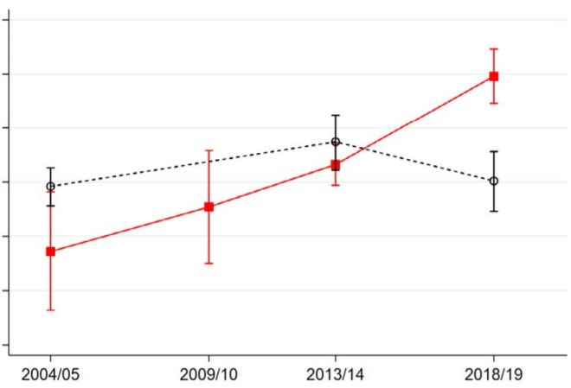
Two Canadian cities were once fluoridated
STUDY: The prevalence of cavities, extracted, missing or filled primary teeth (children in Grade 2)
% of children who had experienced at least one cavity
ay
dec h
oot t
d e
nc
e i
per ex
had
ho w
dren
l
hi c
of
%
70
65
Calgary children Edmonton children
60
55
50
45
40

Slide 21
Look at what happened in Calgary
STUDY: The prevalence of cavities extracted, missing or filled primary teeth (children in Grade 2)
% of children who had experienced at least one cavity
ay
dec h
oot t
d e
nc
e i
per ex
had
ho w
drn
l
e
hi c
of
%
70
Calgary ends fluoridation (2011)
Calgary: 65%
65
60
Calgary children Edmonton children
Edmonton: 55%
55
50
45
40

Slide 22

GA-related treatment rose steadily after cessation
The Canadian city of Calgary ceased water fluoridation in 2011. Afterward, its rate of dental treatment with GA steadily rose.
Rate of treatment under GA per 10,000 children
7 years after the city stopped
35
3 years after the city stopped
But the GA rate in Edmonton barely changed. It stayed in this narrow band.
30
25
When Calgary ended fluoridation
20
15
10
Calgary children Edmonton children
5
0
(Source: Yazdanbakhsh E, et al. Community water fluoride cessation and rate of caries-related pediatric dental treatments under general anesthesia in Alberta, Canada. Canadian Journal of Public Health, 2024 / doi: 10.17269/s41997-024-00858-w.)

Slide 23
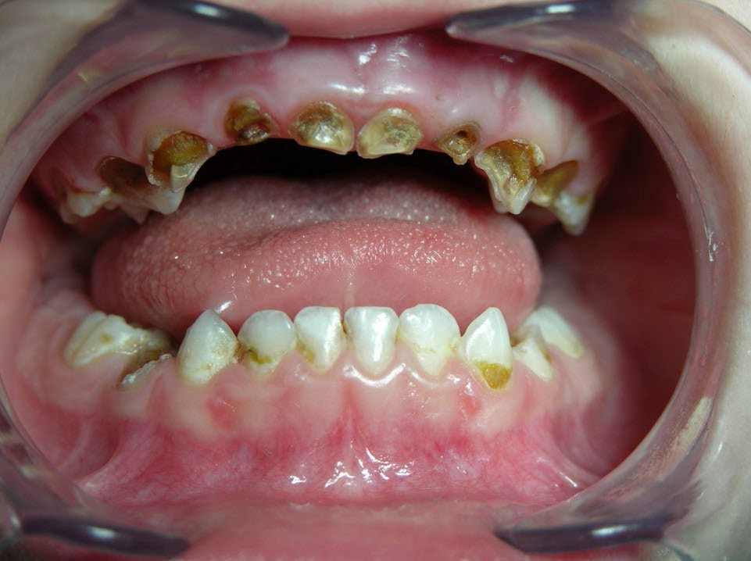
How severe decay in children is treated
A toddler’s teeth can begin to suffer cavities (decay) soon after they appear in the mouth. Without fluoridated water and fluoride toothpaste, a child is at greater risk.
Toddlers and young children with severe decay may not tolerate or cooperate for treatment in a dental office. The only option to safely treat them is under general anesthesia (GA) in a hospital.

Slide 24

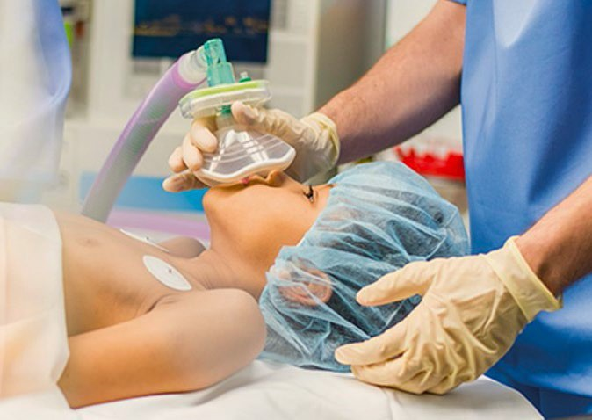
How severe decay in children is treated
Although deaths from the use of GA are very rare, they do happen. And preschool-age children are the most vulnerable.
GA-related treatment is also very expensive.
(Source: Lee HH, et al. Trends in death associated with pediatric dental sedation and general anesthesia, Paediatric Anesthesia, 2013; 23(8):741-6. doi: 10.1111/pan.12210)

Slide 25
How severe decay in children is treated
The average cost of hospital treatment with GA ranges from
$10,000 to $15,000 per child.
US and international studies show that water fluoridation helps prevent 2/3rd of hospital GA dental treatment.
(Sources: J. Daley, “Tooth Decay: A Silent Epidemic, Especially For Poor Kids In Colo.,” Colorado Public Radio, March 12, 2015; An alternative marker for the effectiveness of water fluoridation: hospital extraction rates for dental decay, a two-region study, Elmer et al, British Dental Journal 2014; 216: E10; Klivitsky et al., “Hospitalizations for dental infections - Optimally versus non-optimally fluoridated areas in Israel,” Journal of the American Dental Association.)

Slide 26
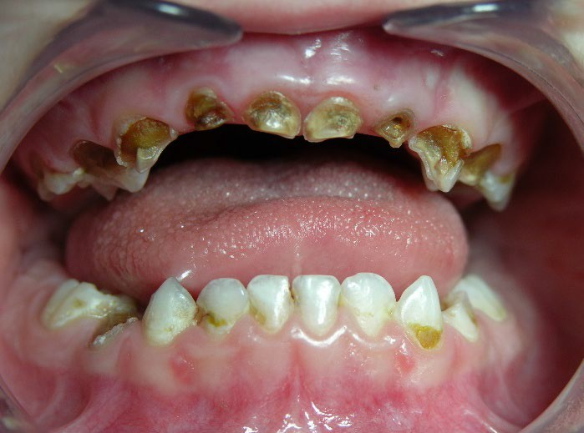
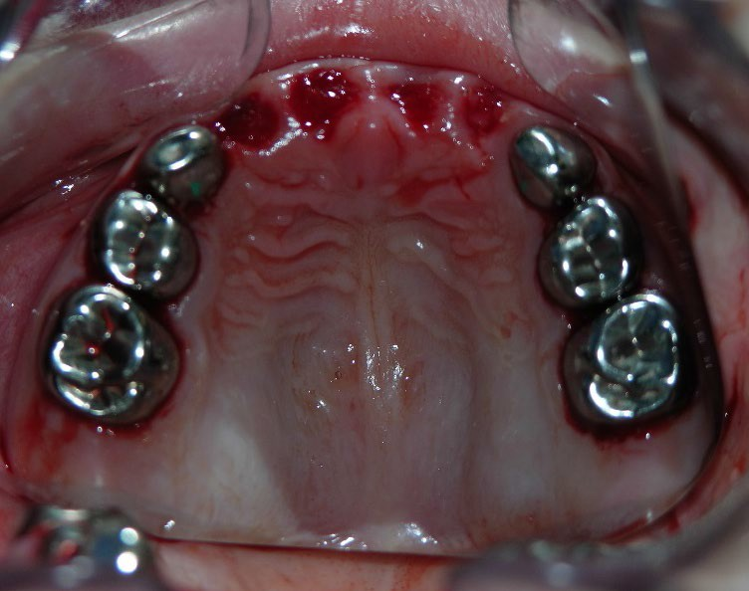
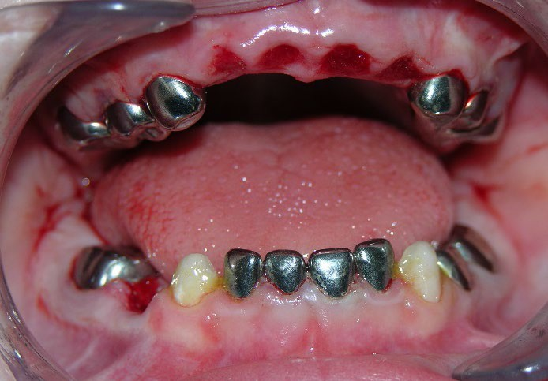
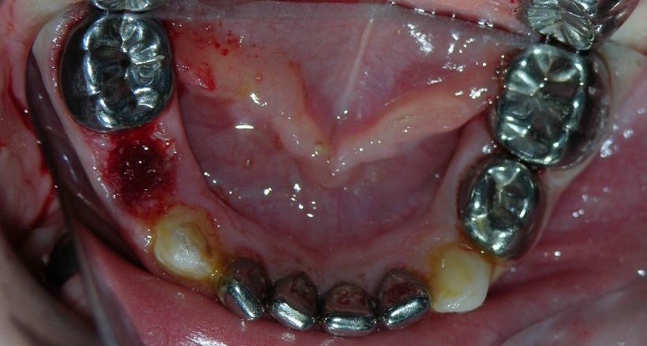
How severe decay in children is treated
(Sources: An alternative marker for the effectiveness of water fluoridation: hospital extraction rates for dental decay, a two-region study, Elmer et al, British Dental Journal 2014; 216: E10; Klivitsky et al., “Hospitalizations for dental infections - Optimally versus non-optimally fluoridated areas in Israel,” Journal of the American Dental Association.)

Slide 27
Cost savings
Fluoride provides an extra benefit in that every dollar invested saves an average of $32 per person in avoided dental treatment per year
Current cost for community water fluoridation is approximately 50 cents per person, per year, which is a fraction of the cost of repairing one cavity
Safe, cost-saving and effective in preventing cavities for all people, children and adults, regardless of income

Slide 28
Leading health & scientific groups that SUPPORT fluoridation
American Water Works Association – over 51,000 active members
American Academy of Pediatrics – approximately 67,000 active members
American Dental Association – over 159,000 active members
Centers for Disease Control and Prevention
American Academy of Family Practitioners – over 129,000 active members
American Nurses Association – 4 million active members
American Medical Association – over 270,000 active members
American Dental Hygienists Association – over 226,000 active members
Department of Defense – Memo regarding fluoridation of military bases around the world
World Health Organization*
( *WHO Global oral health status report - Towards universal health coverage for oral health by 2030; Water fluoridation, section 3.3.2)

Slide 29
Leading health & scientific groups that OPPOSE fluoridation
0

Slide 30

Questions??

